Slide 1
SWEN Assignment 2
Done By: Faizal, Ronald, Syazwani, Mervin
P02

Slide 2
Requirement Specifications

Slide 3
Functional Requirement
Functional requirements portray the fundamental actions that the system should allow.
The functional requirements are divided into 5 main categories
Check-In
This take notes of guest information and any additional requirements
Check-Out
This take notes of the payment details and any additional payment if the guest have consume anything from the mini bar
Housekeeping
This module take notes of the duties and the status of the housekeeping. This is also to know the name of the staff that have completed their jobs
Staff Management
This take notes of staff information and particulars
Report
This take notes of all the hotel’s report to generate, review, export or print.

Slide 4
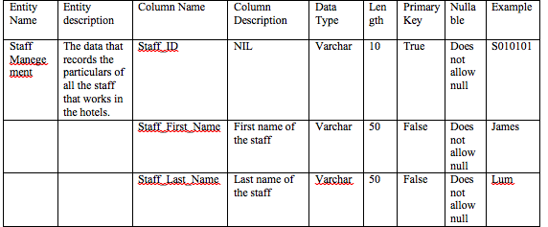
Data Requirements
(Data dictionary)
Notes:
The rest of the details is in the SRS report. This is just a preview of the data dictionary.

Slide 5
User Interface Requirements
Different User Interface screens
Login – allow users to login as customer/staff
Booking – allow users to create new booking, retrieve booking info, update booking and cancel booking
Check-in – allow users to check-in to room and modify room stay
Checkout – allow users to checkout
Customer Record – allow users to add/update customer record
Administer Rooms – allow users to check availability and rates of rooms
Administer User – allow users to create, modify and delete users and change password

Slide 6
Operational Requirement
System will be deployed in the administrator room’s computer
It will also be deployed in the reception counter’s computer. (Makes use of one main copy of the system which is located at the administrator room through Virtual Desktop Infrastructure (VDI) software)
VDI software makes use of the broadband connection
Convenient for all the users of HMS as each possess different rights (i.e. Different Login credentials)
Management/Administrator users have their own computer and need not use reception computer

Slide 7
Design Specifications

Slide 8
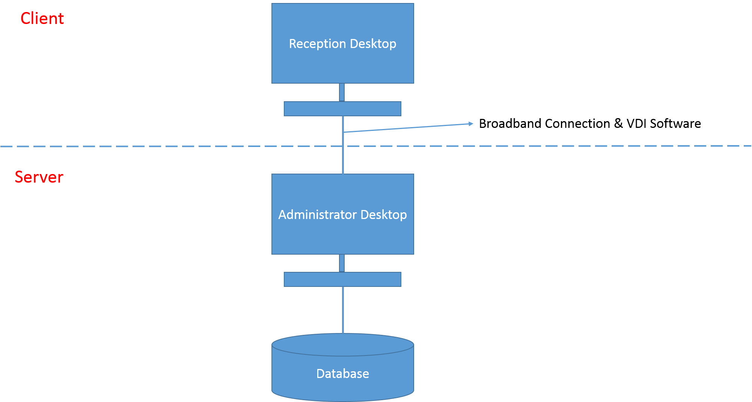
Architecture Design

Slide 9
Architecture Design
Client - 2 desktop computers
Reception desktop
Administrator desktop
Server - Administrator desktop
Provides the reception desktop the HMS through a VDI software connected via broadband connection
1 separate large database – Accessed by Administrator desktop (and Reception Desktop through VDI usage)

Slide 10
User Interface Design
What is User Interface (UI) Design?
The design of user interfaces for machines and software to maximize user experience
Goal
To allow users to achieve their goals in a simple and efficient manner
Form of UI
Windows
Allows access to system resources on computer
Level of access can be restricted

Slide 11
User Interface Design
Login screen
2 textboxes (Customer/Staff ID, Password)
1 button (Login)
Booking screen
4 buttons (Create Booking, Retrieve Booking, Update Booking, Cancel Booking)
Check-in screen
1 button (Modify Check-in)
Checkout screen
2 buttons (Checkout, Cancel)

Slide 12
User Interface Design
Customer Record screen
2 buttons (Add Record, Update Record)
Administer Room screen
2 drop-down list (Room No., Room Type)
1 button (Check Availability)
Administer Users screen
4 buttons (Create User, Change Password, Modify User, Delete User)

Slide 13
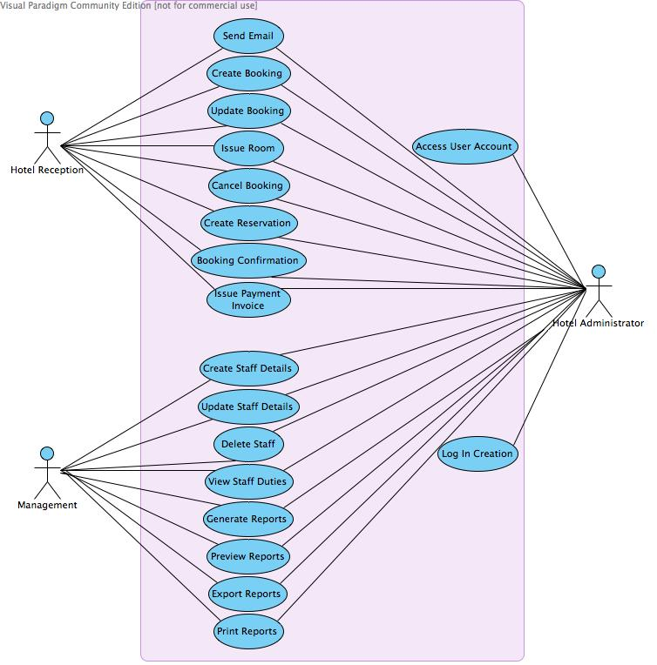
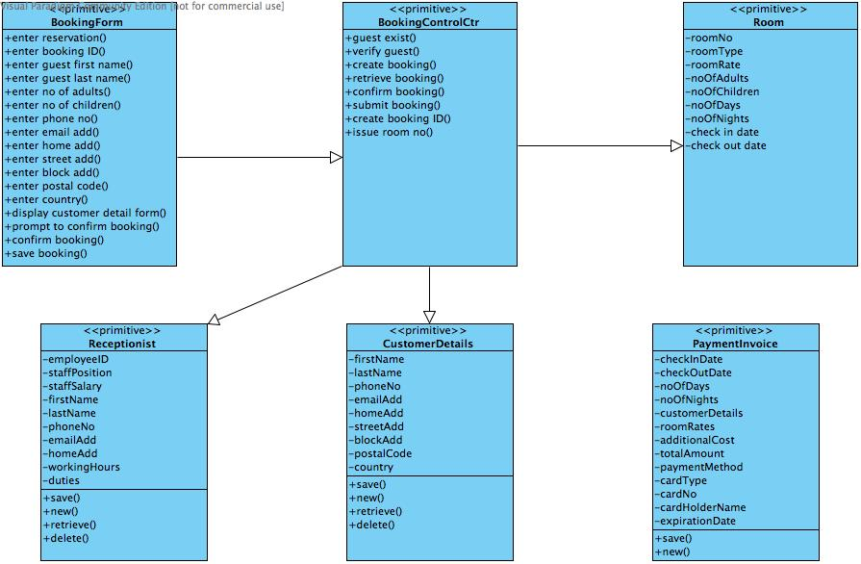
Program Design

Slide 14
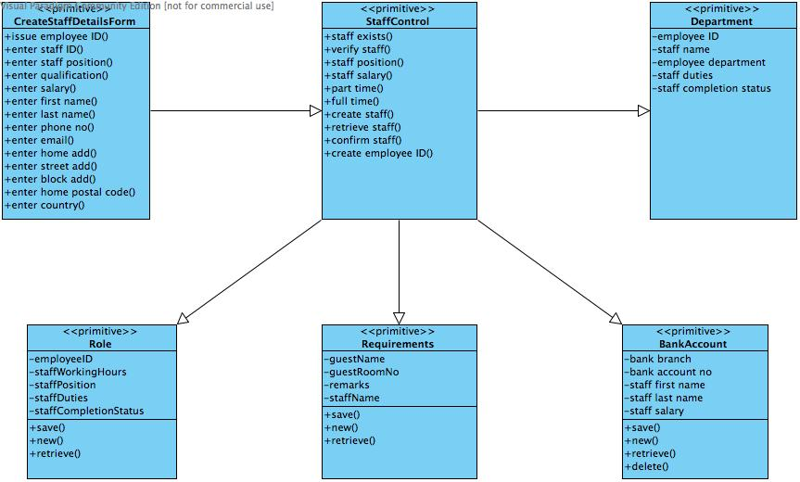
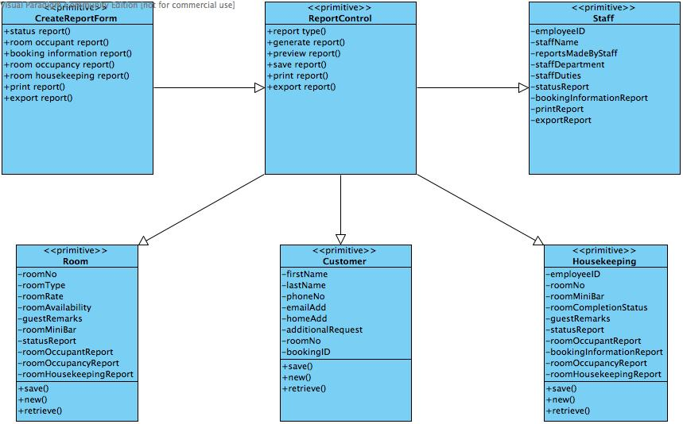
Program Design
Housekeeping & Staff Management VOPC Report VOPC

Slide 15
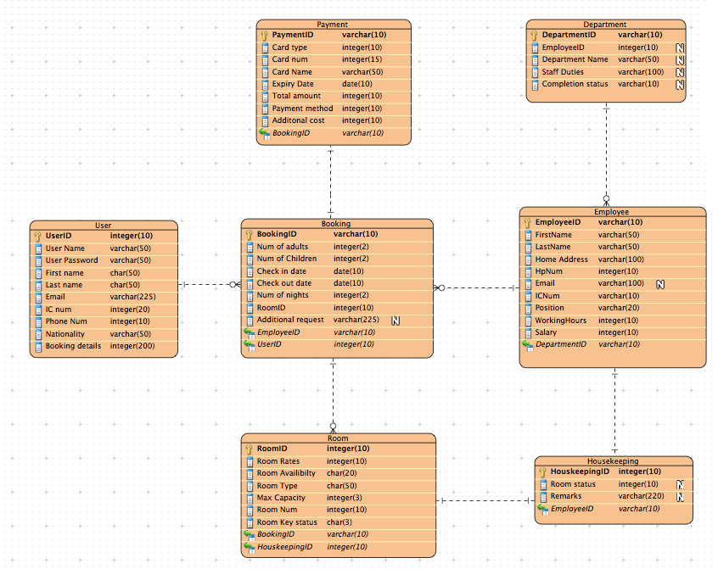
Database Design

Slide 16
Considerations and decisions
Adopting normalized schema for the database design.
Using OLTP as the main inspiration for the design.

Slide 17
Why deciding to use OLTP?
Less complex.
Tables are split into smaller parts to reduce inconsistency
Prevent loss of time and profit of the hotel.
Able to handle a lot of users at the same time preferably with a low latency.
Customers do not need to wait to book.
Has a short response time compared to other database system.
Allows maintenance to be run in the background.

Slide 18
How does your database design solve your data storage requirements?
Solve by partitioning.
Partitioning will help to reduce the space requirements as selected parts of the database can be compressed.
Partitioning will allow lower the cost of storing vast amount of data, as data are stored. transparently on different storage tiers.

Slide 19
Limitations
Financial transaction processing cost
OLTP deals with a lot of online transactions.
So it will impose a large cost on all the cost on financial transaction processing.
Therefore, financial institutions will impose cost of booking on the hotel.
charged on a monthly basis or at minimum fees.

Slide 20
Limitations
Atomicity
Refers to a booking transaction in which either all the database steps succeed or entirely failed.
If any one step goes wrong, and the transaction continues anyway, you'll probably end up with data errors or corruption.
That could be devastating for hotel.

